Slide 1


Slide 2
Distribution and Control of
Air-Current

Slide 3
Controlled distribution of air is necessary
  for supplying the required quantities of air to various parts of a mine as well as
  for minimizing the dangers due to fires, explosions etc.

Slide 4
Case I: Requirement of lower quantity of air
Case II: Requirement of higher quantity of air
Case III: No requirement of air

Slide 5
Methods for reducing the quantity of air flowing through an airway
By increasing the resistance of the airway, as Q α 1/√R: done by introducing a regulator in the airway.
  This method is wasteful though most practicable.
By reducing the main fan pressure causing flow:
  This method involves less wastage.
  This method requires special adjustments in the fan and rarely practiced.
  Also, reduction in main fan pressure affects flow in other airways.

Slide 6
The airflow can be completely stopped (except for small leakage) by erecting stoppings in the airway
  if the airway is not to be used as a traveling road or haulage-way.
Incase access through the airway has to be maintained, doors have to be used for stopping the airflow.

Slide 7
Methods for increasing the quantity of air flowing through an airway or a circuit of airways
By reducing the resistance of the airway or a circuit of airways:
Decreasing resistance for increasing the air quantity can be achieved by
  Increasing the cross-sectional area of the airway
  Smooth-lining the airway or
  Using several airways in parallel: best method.

Slide 8
The best method of increasing air-flow through a district is by dividing more than one airway in parallel serving the district.
If
n = no. of similar parallel airways (i. e. their lengths, cross sectional areas or nature of surface are same) supplying air to a district or face
R = resistance of each airway
Rn = total resistance of all the airways
As the openings are in parallel
1/√Rn = n/√R
or Rn = R/n²

Slide 9
If
P = pressure across the openings
Qn = total quantity of air flowing through them
Q = quantity circulating through a single opening of resistance R
Qn = √(P/Rn) = √(Pn²/R) = n√(P/R) = nQ
(Or the quantity is multiplied as many times as the number of splits)
Also the air power increases by n times.

Slide 10
By increasing the pressure causing flow: is not as efficient as the other method
Since, Q α √P
or for doubling Q, P has to be increased four times.
Again, since Power α PQ α Q3
Q α (power)^{1/3}
(or for doubling Q, the power has to be increased eight times.

Slide 11
It is thus evident that by providing parallel airways, if the quantity is doubled, the power consumption is doubled.
Whereas, if quantity is doubled by increasing pressure, the power consumption goes up eightfold.
As required by law nowadays, double intake airways have to be provided in gassy coal mines. This not only reduces the effective resistance of the intake but also provides a traveling way separate from the haulage way. Also sufficient ventilation can be maintained even if one of the intakes is temporarily blocked by a roof fall.

Slide 12
Splitting
A split is a branch of air current taken from the main air current which travels inbye from the DC shaft.
Each ventilating district is ventilated by a separate split.
When a mine has several working districts, it is preferable to divide or split the air required for the mine to the respective quantities needed in these districts and supply them through separate ventilation routes or circuits in parallel.
Splitting, as a means of distributing air from the shaft to the face, was first adopted by John Buddle in 1810 in the coal mines of UK.

Slide 13
For ideal air distribution,
The splits should have resistances commensurate with their air requirements.
They should be fairly long so that the trunk airways connecting them to the shafts at both ends are as short as possible, as these trunk airways can cause large friction losses.
The number of splits should be neither too large nor too small.
  Too few splits cause a large number of faces to be ventilated by a single split
  Too many splits may produce sluggish ventilation at the face.
According to German regulations, there should be one split for every 100 men in gassy coal mines.

Slide 14
Advantages of splitting
Splitting helps in providing fresh uncontaminated air to each ventilating district.
As the airways are in parallel, splits reduce the overall resistance of the mine and increase the fan quantity.
Control of air quantities delivered to different districts as per their needs can be done easily by controlling the resistance of the splits.

Slide 15
Explosion, fire, gas emission or roof fall occurring in one district can be easily confined to that district by suitable ventilation control measures and does not affect other districts.
Splitting helps in keeping down air velocities in roadways by distributing the quantity through several openings and thereby reducing the coal dust formation.
Reduced air velocity has reduced drying effect on the coal dust.

Slide 16
Disadvantages of splitting
Necessity of maintaining a large number of airways.
Addition of greater amount of heat to the air by virtue of its low velocity and contact with a larger rock surface in the splits.
A large number of splits results in proportionately less quantity in each district and consequently reduced velocity which may not be able to clear off gas or may not provide adequate ventilation to the district.

Slide 17
VENTILATION CONTROL DEVICES

Slide 18
Air is coursed to the working places in a mine by the use of various devices:
Ventilation stoppings
Ventilation doors
Air locks
Air-crossings and
Regulators

Slide 19
Ventilation stoppings
Stoppings may be
  Temporary or
  Permanent
Temporary stoppings
Temporary stoppings in coal mines are usually made of
  brattice cloth,
  tarred paper or
  plastic cloth with wire netting reinforcement
  Inflatable plastic stoppings: rarely used in metal mines where the stronger blasting concussion might damage them. They make a poor fit against the rough walls of the drives in metal mines and hence cause a lot of leakage.

Slide 20
They can be hung as curtains for allowing access through the roadway or nailed on to a framework, the former allowing more leakage. Even the latter can allow substantial leakage at the periphery of the airway.
In metal mines temporary stoppings are usually made of wooden boards nailed on a skeleton frame of wood, the gap between the boards and those between the boards and the rock walls being closed air-tight by stuffing them with rags and plastering with clay.

Slide 21
Permanent stoppings
In coal mines these are usually made of incombustible material, viz. brick, stone or cement-concrete walls.
They require a good foundation reaching up to solid unfractured ground surrounding an airway for preventing leakage (in case to seal off fire areas).
The thickness of a ventilation stopping is of minimum of 38 cms of brick or stone in lime or cement and plastered to prevent leakage of air (DGMS Cir. No. 17 of 1964)
According to CMR, all stoppings between main intake and returns should be either of brick work or masonry of a minimum thickness of 250 mm and suitably plastered by lime or cement mortar.
DGMS recommends a 1.5 m thick brickwall for explosion proof stoppings.
Important fireproof and explosionproof stoppings in coal mines should preferably be made of brick (two-brick thick) or concrete walls, spaced out a certain distance, depending on the strength desired, and with the intervening space filled tight with broken rock, sand and clay etc.

Slide 22
Ventilation doors
Where access through stoppings is essential for haulage or traveling purpose, doors are used.
The term door usually means the assembly of both door and frame.
Doors should open against the intake air so that the air pressure automatically keeps it closed.
The frames are set in suitable air-tight stoppings, made usually of cement concrete and the doors hung from them by means of two to three strong strap iron hinges.
CMR require that the thickness of the masonry or concrete wall in which the door frame is set should not be less than 250 mm.
Single doors are most common in use though double doors are sometimes installed where a wide opening is required.

Slide 23
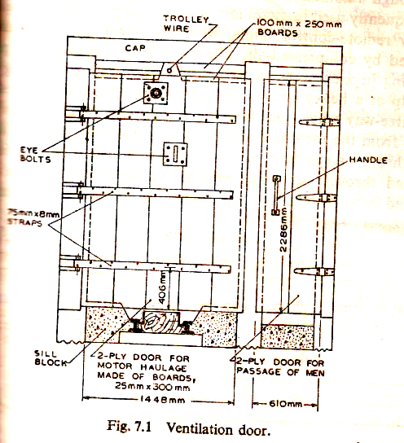

Slide 24
Doors range in size from about 1.5 x 2m in metal mines and up to 2 x 4 m in coal mines depending on the width of cars that have to pass through the door.
Airways which are frequently used for passage of men only, small doors of 0.6 x 0.9 m size may serve the purpose.
Door frames and doors are often made of wood suitably treated with a fire retardant though steel or light metal doors in angle-iron door frames are used in mines where corrosion by acid mine water is negligible.
Metal construction is preferable for fire doors. Indian CMR require all ventilation doors to be fireproof construction.

Slide 25
Wooden door frames are usually made of 150 x 150 mm or 200 x 200 mm timber.
Doors, of two layer of 25 mm thick wooden boards with tarred cloth or paper between the layers are used.
The boards in each layer are placed at right angles to each other, i.e. one horizontally and the other vertically and are held together by clinched nails.
Steel doors should have a minimum thickness of 3 mm.

Slide 26
Doors should preferably open on one side, i.e. the high pressure side, opening in the other direction being checked by the frame.
They should be so installed that they close automatically if left open.
In coal mines this is commonly achieved by installing the frame at a small angle of about 0.175 rad (10 degree) with the vertical so that the door closes by its own weight.
For minimizing leakage across doors, the doors should overlap the frame and be provided with a gasket lining.
Canvas or rubber strips fixed along the bottom edge of the door reduce leakage appreciably.
Drainage ditches should be provided with water seals in order to prevent leakage.

Slide 27
Air-locks
An air-lock is a set of two doors so installed that one of them is always shut when the other is opened to pass men, tubs or a train.
This is not only minimizes the leakage but becomes essential where the ventilation system is likely to be disturbed seriously by too frequent or prolonged opening of doors.
In fact air-locks should always be provided where the pressure across the door is high. Indian CMR require that air-locks should be provided between main intakes and returns.
Doors in an air-lock should be so spaced as to accommodate the longest length of train required to pass through it.

Slide 28
The pressure on single door should not exceed 250 Pa, in order that they offer no difficulty in opening, whereas pressure up to 500 Pa can be allowed with air-locks.
Beyond this pressure, even air-lock doors are difficult to open and small shutter have to be provided on each of the doors. The smaller shutter is more easily opened under high pressure and once it is open, air pressure across the door gets equalized, as a result of which it becomes fairly easy to open the main door.
On important airways in gassy coal mines, it is a common practice and even enforced by law in some countries to provide three or more doors so that the air-lock is maintained even if one of the doors is out of order.
One of these doors should preferably open in the opposite direction to the others so that the air-lock remains effective in the event of reversal of air-current.
Operation of the doors of important airlocks are interlocked so that when one of the doors is open, the other is automatically kept closed.
Alternatively an automatic warning device should be installed on each door to indicate if the other door is open or closed.

Slide 29
Air-crossings
Air-crossings are constructed where intake and return air currents have to cross each other.
These should be leakage proof, fireproof and have ample cross-section.

Slide 30
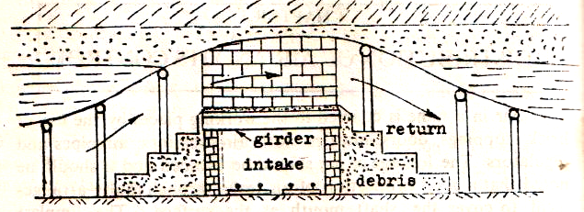
Normally these are constructed at a place where it has a reasonably long life and the ground is free from rock movement.
Air-crossings in gassy coal mines (deg. II and III) should be explosion proof.

Slide 31
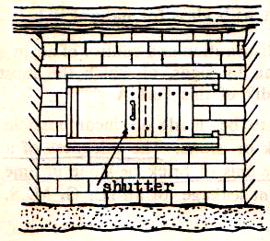
Regulators
A regulator is a window of adjustable opening consisting of a sliding shutter left in stoppings.
This helps in adjusting the size of the opening to suit the requirement.

Slide 32
The air quantity can be adjusted by varying the size of the opening.
The shutter of the regulator can be locked in position to prevent tampering by workers.
Introduction of a regulator in a roadway increases the resistance to air.
The regulator has the effect of reducing the air flowing in the regulated split and the same time increasing the volume of air flowing in the unregulated split.

Slide 33
If a return airway is common to two districts and one of the districts has to be regulated, the regulator must be placed in the intake airway of the split to be regulated.
If such intake airway of the split to be used for traffic of tubs or workers it is not possible to fit the regulator in a stopping and it should therefore be fitted in a ventilation door.
Regulators can be permanent when they are constructed of steel in a concrete stopping, but more often they are temporary in nature.
The size of the regulator can be normally calculated by using the equivalent orifice.

Slide 34
Quantity and Pressure Requirements of Mine Air

Slide 35
Quantity of air flowing in a mine should be adequate
To supply sufficient oxygen
To dilute impurities in mine air, viz. inflammable & noxious gases as well as pathogenic & inflammable dusts to safe concentrations.
To clear away smoke and steam.
To dilute heat and humidity of mine air
To producing sufficient face air velocity

Slide 36
Air quantity required in the workings
  Mine air must contain 15% oxygen,
  A fresh air supply at the rate of about 0.125m³/min/man is required to maintain O₂ supply at 19%
  To maintain CO₂ % below 0.5%, a quantity of 0.5m³/min/man is to be supplied to the working places
  Common industrial requirement – 0.3 to 0.9m³/min/man in buildings
  Burning of lamps, oxidation of coal and timber etc. deplete the O₂ content of air
  Mine air may be fed with other impurities such as methane, hence fresh air supply should be more than industrial requirement.

Slide 37
Diluting impurities in mine air, viz. inflammable and noxious gases as well as pathogenic and inflammable dusts to safe concentrations.
  % of inflammable gas in the return of the district below 0.75%.
  Where electrical machinery is used particularly at the face – the methane % should not exceed 0.5%
  In very gassy mines, to dilute the methane to this concentration may cause undesirable high velocities at the face, efforts should be made to use compressed air machinery at the face, so that allowance of limit for % of methane is raised to 0.8% near the face.

Slide 38
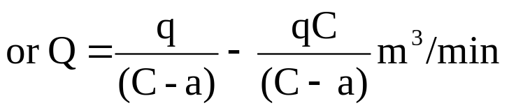
(iv) Let
Q = Rate of air flow to dilute the methane to the maximum allowable concentration, m³/min
C = Maximum allowable concentration
a = Concentration of gas present in the intake air
q = rate of gas emission, m³/min
The volume of exhaust air is increased by q, the amount of gas added in a unit time. Writing the gas balance equation per unit time
Gas in intake air + gas added in the workings = gas in the exhaust air
Q.a + q = (Q + q) C

Slide 39
For a new mine, where methane emission data is not available, this data should be taken from any other mine being operated within the area
If a mine is planned for a depth for which no methane emission data is available, it would be wise to allow a 10% increase in the rate of gas emission for every 100 m depth.
Any estimation of quantity should be based on the peak production rate of methane.
It has been suggested that half hourly samples at the inbye end of the intake gate and outbye end of the return gate have to be taken for 3 to 6 months in order that rate of methane emission can be predicted with accuracy.

Slide 40
CO and Nitrous fumes to be brought down to levels of 50 ppm and 5 ppm respectively. (To be diluted within 5 minutes of blasting)
(3) Diluting heat and humidity of mine air
Supply proper quantity of air to reduce heat and humidity
(4) Producing sufficient face air velocity
A face air velocity of 0.5 to 2 m/s is reasonable for comfort condition
Velocity above this generally raises dust and discomfort
Air velocity of higher magnitude is sufficient for creating turbulent diffusion of contaminants

Slide 41
Standards of Ventilation
6 m³/min/man employed in the district in the largest shift, 2.5 m³/min/te of daily output
  Whichever is larger passes in the last ventilation connection in the district
O₂ < 19%
  CO₂ > 0.5% at any place
Methane > 0.75% in the general body of the return
      > 1.25% in any place in the mine
WBT > 33.5 ºC in any working place
  If it exceeds 30.5 ºC attempts to ventilate it with a velocity > 1 m/s.

Slide 42
Gassiness of Underground Coal Mines
Degree I gassy mine
  % of inflammable gas in the general body of air > 0.1%
  Rate of gas emission > 1 m³/te of daily output
  Degree II gassy mine
  Inflammable gas > 0.1%
  Rate of gas emission > 1 m³/te of daily output < 10 m³/te of daily output.
  Degree III gassy mine
  Rate of gas emission > 10 m³/te of daily output

Slide 43
Recommended Air Velocity
Degree of gassiness | Place where velocity of air to be measured | Minimum air velocity, m/min
Degree I | Immediate outbye ventilation connection | 30
Degree II | 4.5 m from face in the intake side of brattice partition | 30
 | 7.5 m outbye of the discharge end of an air pipe | 15
 | At the maximum span of the longwall face | 60
Degree III | 4.5 m from face in the intake side of brattice partition | 45
 | 7.5 m outbye of the discharge end of an air pipe | 25
 | At the maximum span of the longwall face | 75

Slide 44
Recommended Maximum Air Velocity
Locality | Maximum velocity
Ventilation shaft without man and material winding | 15 m/s
Ventilation shaft with material winding | 12 m/s
Shaft for man winding and haulage roads (other than conveyor roads) | 8 m/s
Other roadways | 6 m/s
Conveyor roads loading pt and transfer pts | 4 m/s
Working faces in development or depillaring/stoping areas including L/W faces | 4 m/s

Slide 45
Air requirement in drifts and tunnels
ILO recommendation – 0.175 m³/s/m² of drift face area
For a coal heading
Dilute methane or inflammable gas to safe limit
Dilute noxious gases to safe limit
Satisfy statutory norms of ventilation 6 m³/min/man
Other places
Ventilation of internal hoists – 2.3 m³/s
Battery charging station – 4.7 m³/s

Slide 46
PRESSURE REQUIREMENT
Pressure requirement to circulate a certain quantity through an airway either from measurement or from calculation as discussion earlier
Friction and shock resistances should be estimated, but it accounts for 70-90% of the total mine resistances
Pressure loss in a shafts to be calculated based upon average quantity flowing in them. Average quantity becomes particularly necessary in deep shafts.
Due consideration for leakage to be given for estimating pressure loss in an airway
Knowing the pressure requirement for each airway, the total pressure loss for the mine is to be calculated

Slide 49
If the mine consists of several 11^{L} splits, pressure required for one with largest resistance to be chosen, control quantity in other split by regulators. If a large regulation is required in these split, which is wasteful, in this case it is advisable to select a pressure requirement more congenial to other splits. The required flow in high resistance split to be boosted up by booster fan.

